Slide 1

Colonial Park sewer extension project
June 24, 2024 Public meeting & Project update

Slide 2
Introductions
Herbert, Rowland & grubic, Inc. (HRG)
  Justin Mendinsky, P.E. – Group Manager
  Steve Malesker, P.E. – Borough Engineer
  Aidan Buckwalter
Dallastown borough council
Dallastown borough staff
  David Garabedian – Borough Manager
  Joe Joines – Maintenance Supervisor & Sewage Enforcement Officer
  Scott DePoe – Zoning & Codes Enforcement Officer/BCO

Slide 3
Agenda
  Current Project Status
  Proposal for Alternate Low-Pressure Sewer System
  Low-Pressure Sewer System & Grinder Pump Overview
  Borough and Homeowner Responsibilities
  Projected Schedule
  Available Homeowner Funding Assistance

Slide 4
Current Project status
  Design of project completed for a gravity sewer system with pump station and force main for sewage conveyance to York Township
  HRG assisted the Borough in receiving PA DEP Water Quality Management Permit
  PENNVEST funding offer received in April 2024
    Low-Interest Loan at County Cap Rates
    1.743% for years 1 to 5; 2.179% for years 6 to 20
    Borough continues to have CFA Grant funds available for project construction
  HRG assisted the Borough in projecting project costs and user rates at PENNVEST funding levels

Slide 5
Current Project – estimated costs
Total Estimated Project Costs
  Gravity Sewer & Pump Station Option:
    $7,200,000
    Includes estimated costs for sewer construction, pump station, power, permitting, engineering, legal and contingency
  Low-Pressure Sewer Option:
    $3,377,000
    Based on conceptual project layout
    Includes Borough purchase of grinder pumps

Slide 6
LOW-Pressure sewer alternative
  The proposed design modification to the sewer extension will utilize low-pressure sewer mains to serve the Colonial Park neighborhood
    Approximately 4,000 linear feet of 2-inch low-pressure sewer
    Approximately 800 linear feet of 3-inch low-pressure sewer
    All sizes need to be further confirmed during design
  All low-pressure mains are likely to be installed within the roadway, avoiding need for easements and construction of deeper gravity sewers on private property
  Eliminates the need for a pump station to convey flows to York Township
  Significantly reduced sewer piping with connection on S. Park Street
  Each property will require the use of a grinder pump connecting to the low-pressure sewer

Slide 7
LOW-PRESSURE SEWER system overview
  System utilizes Grinder Pumps at each connection for sewage conveyance
  A Grinder Pump system consists of a tank which collects raw sewage from the building, a pump to periodically macerate and convey sewage to the public sewer and a control panel
  Generally used in situations where:
    Rolling topography
    Shallow bedrock or difficult soils for excavation
    Can be installed via horizontal directional drilling
    To reduce construction costs (shallower depths, smaller pipes, reduced restoration)
  Following the Colonial Park installation, the Borough will supply the grinder pumps (~$5,000 savings to property owner)
  Property owners will be responsible for ownership and maintenance of the grinder pumps

Slide 8
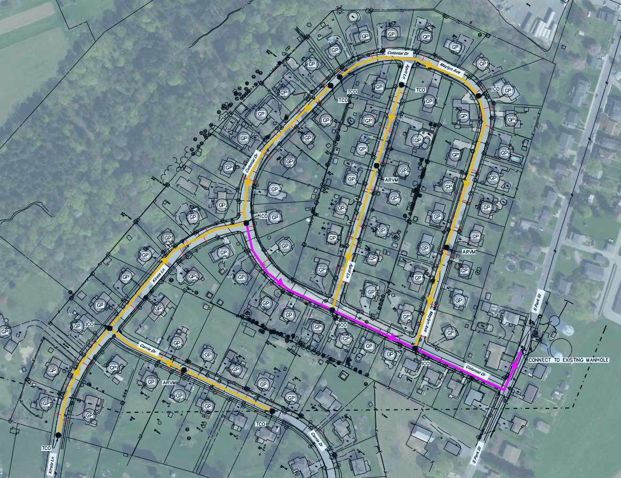
Project Area and overview
Layout is preliminary and
will be refined during
LPSS design

Slide 9
Borough/owner responsibilities

Slide 10
borough/owner responsibilities
LOW PRESSURE SYSTEM
Borough | Property Owner
Construction of low-pressure main in the street Connection to the existing sanitary sewer system in S. Park Street Low-pressure sewer laterals from the main to the ROW, terminated at curb stop/check valve Road and lawn restoration in the ROW Purchase the grinder pumps and control panels; to be provided to the homeowners for installation | Install the grinder pump basin Construct gravity piping from the house plumbing to the grinder pump, and low-pressure discharge lateral from the grinder pump to the ROW connection Install and wire control panel supplied by the borough Abandon the OLDS, restore disturbed vegetative areas

Slide 11
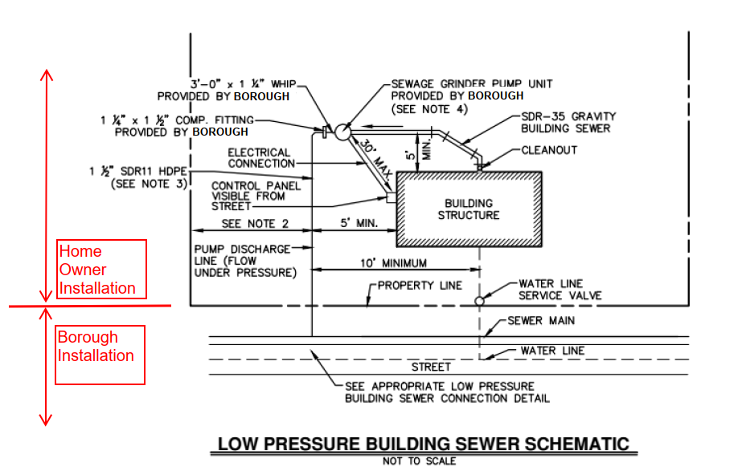
Borough & private installation

Slide 12
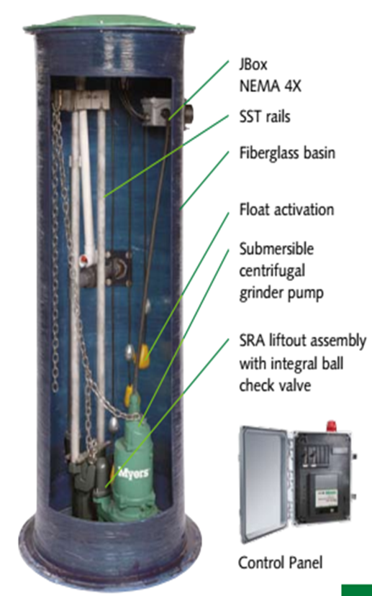
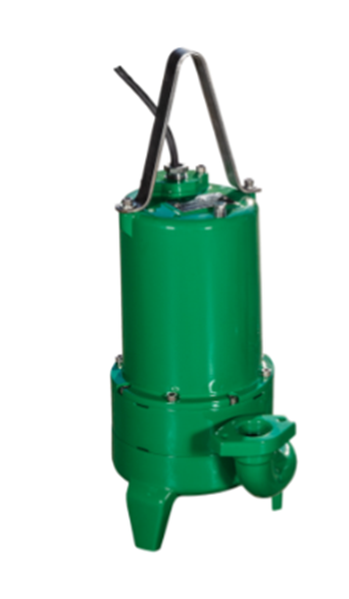
Grinder Pump systems
(provided by borough)
Actual grinder pump model to
be determined during design

Slide 13
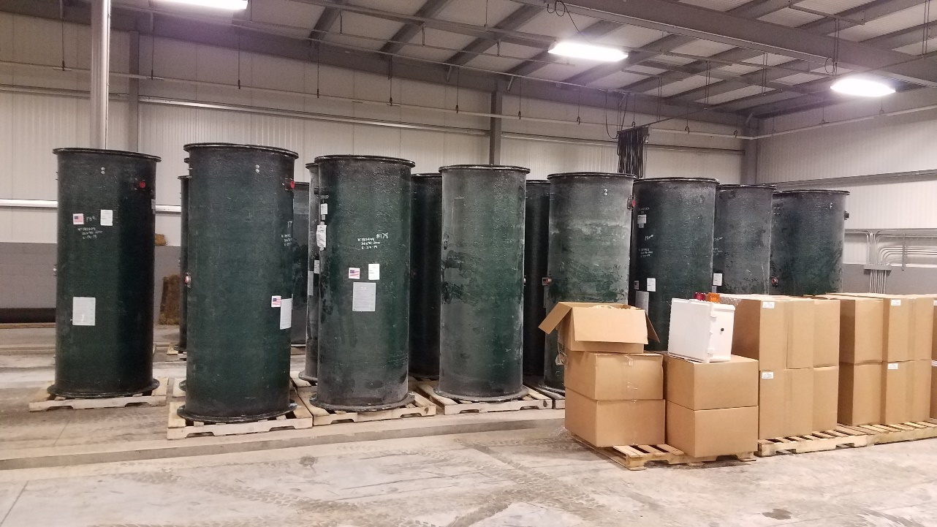
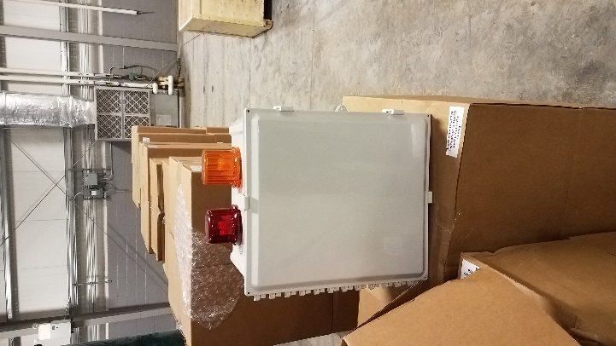
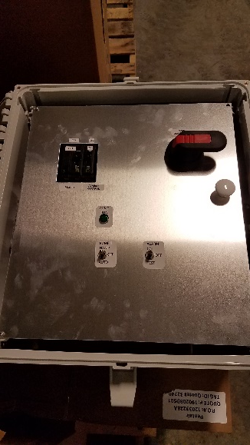
Grinder Pump systems (provided by borough)
Grinder Pump Basins in Storage
Actual grinder pump
model to be determined
during design
Control Panels

Slide 14
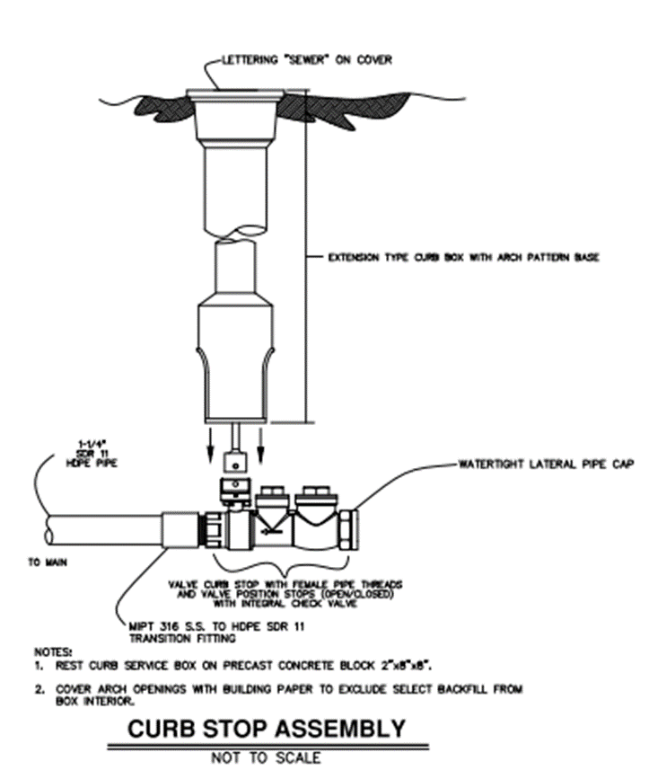
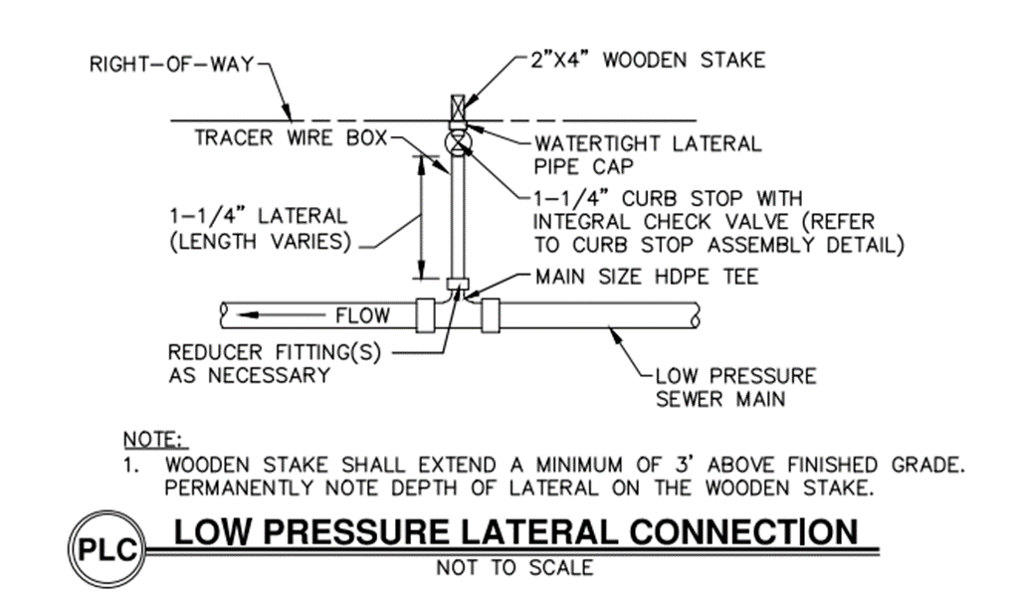
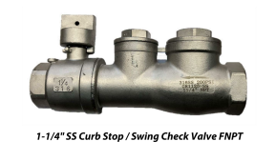
lateral connections (Installed by borough)

Slide 15
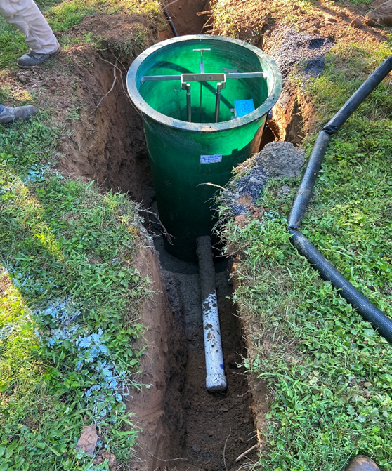
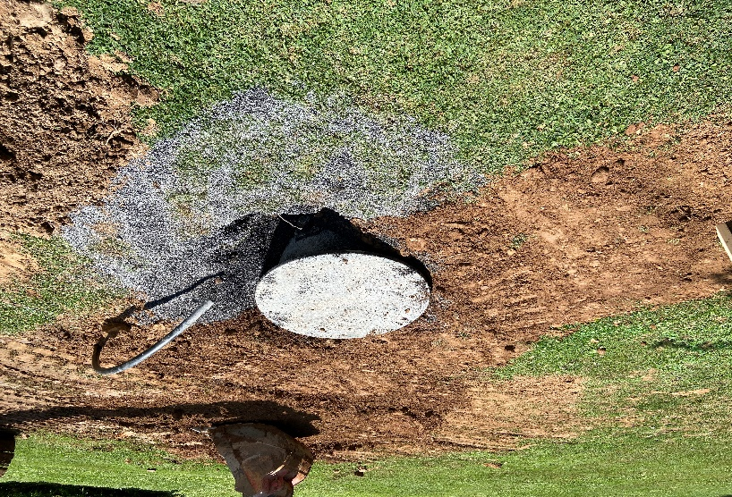
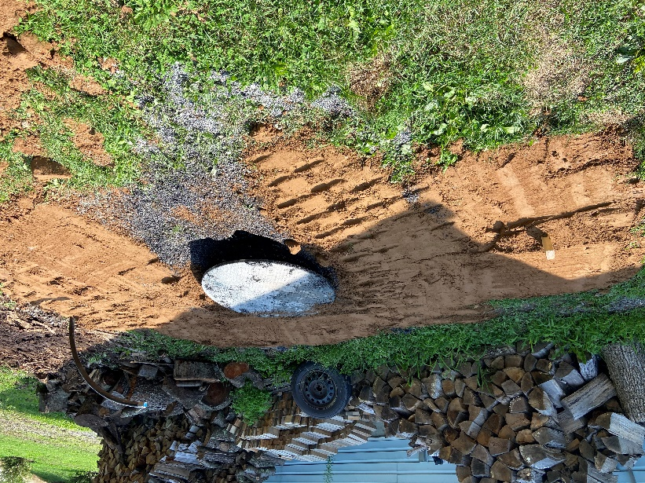
Grinder pump installation requirements – home owner
  The installation of a grinder pump system generally involves the following:
    Installation of 1.25-inch low-pressure sewer lateral from public sewer to grinder pump basin
    Installation of grinder pump, basin, and control panel
    Connection of homeowner effluent to basin and electrical to control panel (240 VAC/ 1 Phase; 35 Amp)
    Additional work may be necessary to reroute homeowner private sewer to grinder pump basin
Installation of grinder pump system

Slide 16
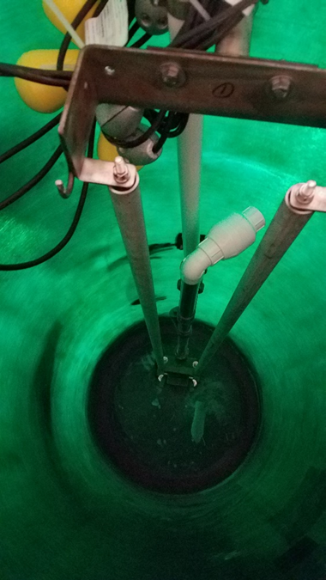
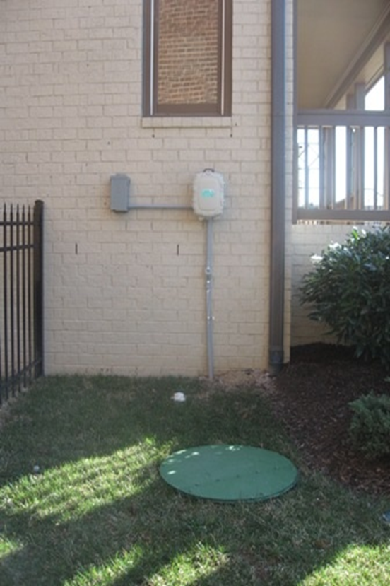
Grinder pump maintenance and operation – Home owner
  To ensure optimum performance and lifespan:
    Regularly inspect the system for any malfunctions
    Ensure ease of access in case of necessary maintenance
    Contact a plumber/contractor in the event of a pump failure
    Do not flush solids, grease, or strong chemicals
    Do not ignore any alarms or signs of failure
Top: Inside of a grinder pump basin; Right: easy access to grinder pump basin.

Slide 17
Grinder pumps faqs
  Power Failure
    Your grinder pump cannot dispose of wastewater without electric power. If electric power is interrupted, keep water usage to a minimum. You may have a high-water alarm upon power restoration, but this will end once the grinder pump is able to pump out the tank.
  Periodic Maintenance
    It is recommended to remove the cover twice a year and hose down the inside of the basin to remove any grease and debris from the walls and level controls. Open the control panel door 3 or 4 times a year to check that there are no alarm lights on.
  Pump Failure Alarm
    The Control Panel is provided with an alarm that will signal in the event of high water in the basin. This provides a warning to the user that service is required. Water usage must be limited until the grinder pump is serviced.
  Manufacturer’s specific information will be provided during project construction upon Borough selection/purchase of grinder pumps and HRG approval of shop drawings

Slide 18
OLDS abandonment procedures – Home owner
  Have a certified pumper/hauler remove contents of septic tank and dosing tanks (if applicable)
  Tanks should be abandoned in one of three ways:
    Remove tank(s)
    Fill tanks with concrete, sand, or stone & cap inlet and outlet piping
    Crush tank in place; break up bottom of tank to avoid ponded water
  Backfill voids with suitable materials (stone, soil, clay)
  Disconnect power to any electrical motors, panels, or instrumentation (alarms)
  Restore vegetative cover
  Sand mounds can be regraded/leveled by applying lime and removing and disposing of the PVC distribution header piping
  Please contact the Borough’s SEO if you have any questions regarding your property

Slide 19
Project schedule - TENTATIVE
Activity | Date
Low-Pressure Sewer Design | July to September 2024
PA DEP Planning & Permitting | August to October 2024
Funding Agency Coordination & Applications | November 2024
Project Bidding | February to March 2025
Construction – Low-Pressure Sewer System | April to November 2025
Construction – Roadway Restoration | Fall 2025/Spring 2026
Resident Connections | Spring/Summer 2026

Slide 20
Available funding sources – private connections
  Residents may be eligible for private funding to pay for costs associated with connection to public sewer
  PENNVEST Homeowner Septic Program
    Eligible Costs: Tapping Fees, Installation of grinder pumps and all associated piping, electrical construction, OLDS abandonment, restoration
    Max loan of $25,000 at 1.75% for 20 years
    No income restrictions for qualified borrowers
Contact for Questions | Example Text
Roberta Schwalm | Brian Stine (American Bank)
(717) 780-3838 | (610) 973-8117

Slide 21
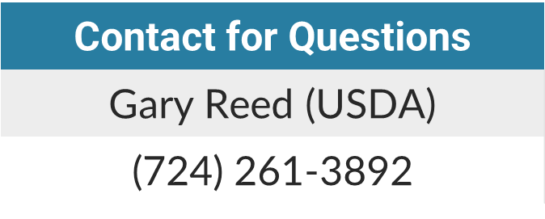
Available funding sources – private connections
  United States Department of Agriculture (USDA) Section 504 Home Repair Program
    Eligible Costs: Same as PENNVEST program
    Max grant of $10,000 for homeowners over 62 years of age
    Max loan of $40,000 at 1% for 20 years for homeowners under 62 years of age
    Applicants must meet USDA income limits to be eligible for funding
  Potential York County assistance – HRG & Borough investigating
  Personal loans, mortgage refinancing, home equity loans, and other forms of financing may be available at banks and credit unions

Slide 22
Future coordination
  Future public meetings will be scheduled by the Borough to provide updates and opportunities for community questions and concerns
  Homeowners shall be notified via mail of upcoming meeting dates and locations
  All public meeting PowerPoints and reference documents shall be made available on the Borough’s website for future use by residents

Slide 23
Reference documents and information
  PENNVEST Homeowner Septic Program:
    https://www.phfa.org/forms/brochures/homeownership_programs/pennvest_brochure.pdf
  United States Department of Agriculture (USDA) Section 504 Home Repair Program:
    https://www.rd.usda.gov/programs-services/single-family-housing-programs/single-family-housing-repair-loans-grants/pa
  Meeting PowerPoint
    To be posted on the Borough Website
    https://www.dallastownboro.com

Slide 24
QUESTIONS?
  Thank you for attending this evening’s presentation!

